Slide 1
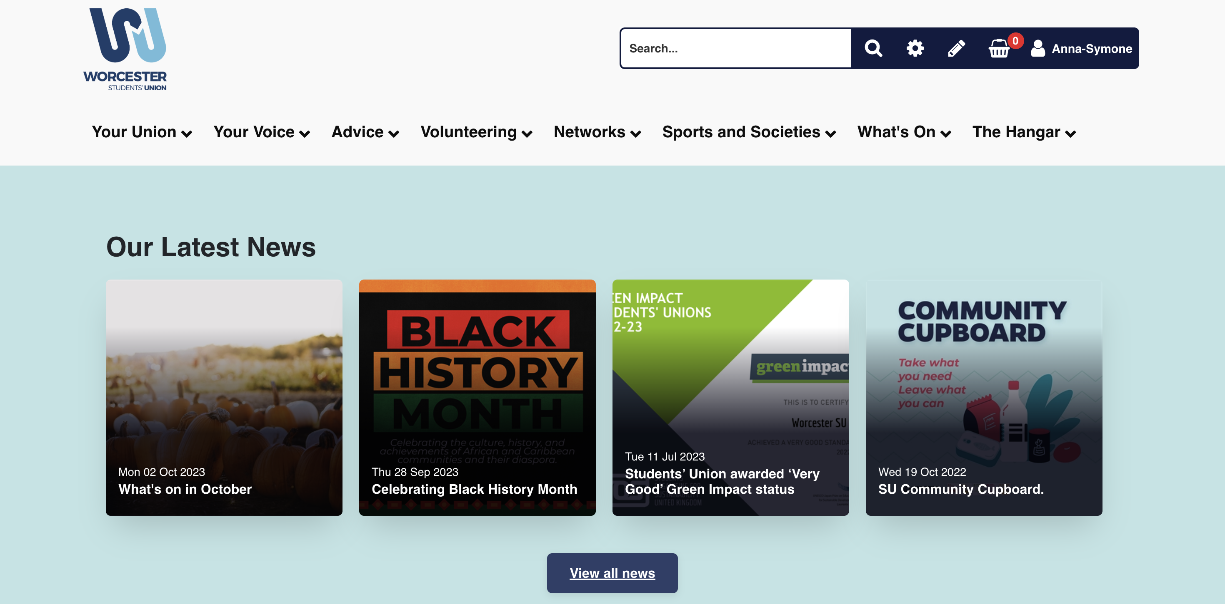
Step By Step Guide
How to Log volunteering hours
Head to worcsu.com and log in

Slide 2
2. Click the “Volunteering” tab and click
“ - - Log Hours - -”

Slide 3
3. The following screen will then appear. Click Community, Elected, SU Crew or TeamWorc Action Days depending on what role you did

Slide 4
4. For this example we have clicked Community. Once here, click “add community Project”

Slide 5
6. Follow the instructions on the screen and click “add” at the bottom of the screen

Slide 6
7. Once you have clicked “add”, this screen will appear. Click the project/role you have created

Slide 7
8. Then click “Log Hours”

Slide 8
9. Complete the fields as required and click ”add” at the bottom

Slide 9
10. Your hours will start appearing here.
To add more hours, repeat steps 7-10
You can also add multiple roles, just repeat these 10 steps again

